Slide 1
What is an LLM?? [Hint: AI]
Presented by:
Hisham Siddique
Network Stack Software Developer
Hisham.Siddique@ibm.com

Slide 2
Agenda
What are LLMs?
- History and Evolution
- How LLMs Work
- Building an LLM
- Use Cases and Applications
- LLM Challenges and Security
- The Future of LLMs

Slide 3
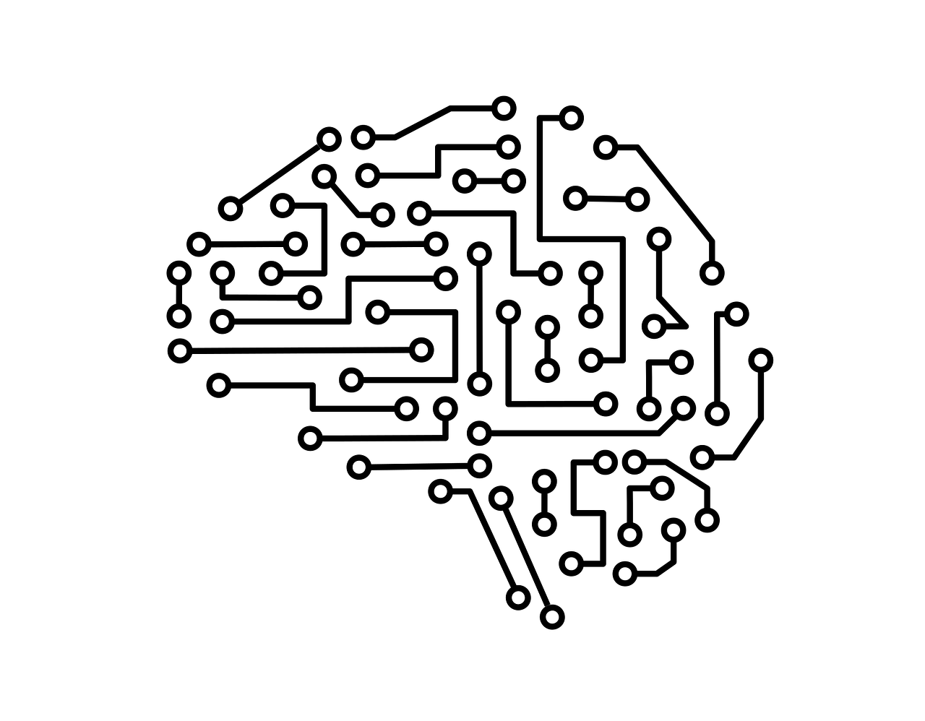
What are LLMs?
Large Language Models
Trained on massive datasets
Objective: Predict the next word in a sequence.
Examples: Watson, GPT, Gemini etc.

Slide 4
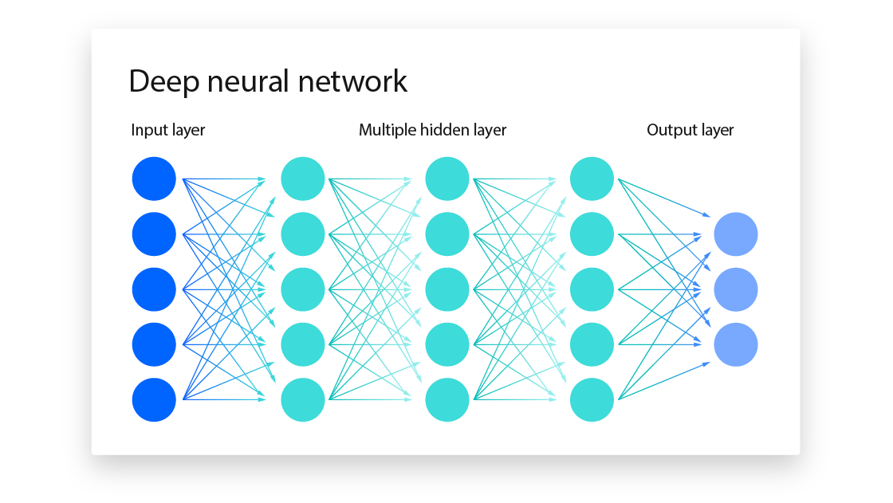
History and Evolution
Early forms of Natural Language Processing:
Word generation based on statistics
Little to no context
The rise of neural networks
Emulating the human brain
Studies towards capturing word relationships
Transformers

Slide 5
History and Evolution
Current Era
OpenAI introduces Generative Pre-trained Transformer (GPT)
Pre-trained on large dataset, fine-tuned
Numerous models out there
Multimodal operation
Specialized LLMs, more efficient training

Slide 6
How do LLMs work?
Key Concepts
Pre-training
Trained on massive text collections
Learns grammar, facts, patterns
Transformers
Use attention mechanisms
Handles long range context
Tokenization
Fine tuning
Adjust for specific tasks
Inference
Prompt
predict and generate text

Slide 7
How do LLMs work?
Pre-training
Take a big chunk of the internet
Train with a GPU cluster for a long time
Self-supervised learning
General understanding
Benefits:
Efficient learning without manual labeling
Generalization

Slide 8
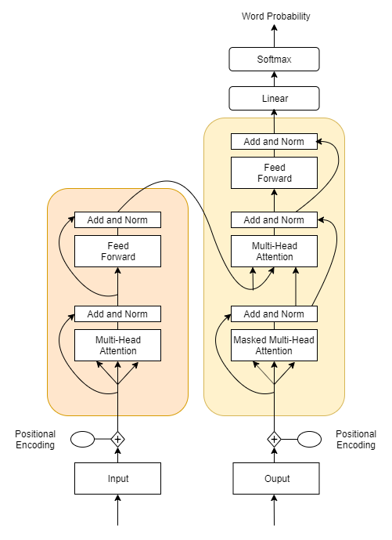


How do LLMs work?
Transformers
Attention: Focus on key words
Handle long range dependencies
Understands connections between words even if they are far apart
Parallel processing
Benefits:
Captures inherent meaning
Much faster than RNNs

Slide 9
How do LLMs work?
Fine Tuning
Task-specific tuning
Adapt model to a particular task
Smaller Dataset
Doesn’t need as much time
Model Customization
Adjusting weights
Benefits:
Efficient specialization for niche tasks
Enhances accuracy for use cases

Slide 10
How do LLMs work?
Inference
Generate response
Adapt model to a particular task
Contextual understanding
Doesn’t need as much time
Works in real-time
Can provide summaries or translations

Slide 11
Lets walk through an example

Slide 12
Building an AI Assistant
So how these assistants get built, what do we need?
A knowledge base
A lot of GPUs
A team to fine tune the model
Incorporate multimodality if needed

Slide 13
Building an AI Assistant
Pre-training
Suppose we want to build an assistant for a car rental company
Create the neural network, with transformers
Train the model with trusted information from the internet about cars, renting, transport etc.
Model generates billions of parameters (think close to 100)
Next word sequence prediction:
THE CAR IS GOING TO ______________
STOP
MOVE
TURN

Slide 14
Building an AI Assistant
Training and test data
Model will generate documents (“dreaming”)
Reversal curse
Generated documents compared to test data
Parameters adjusted
Documents will mirror the format of the data it was trained on
Output measured and iteration continues
Parameter relationship still “black box”

Slide 15
Building an AI Assistant
Dataset = Essay, Wiki article type documents
However, we want an assistant for customers
Fine tuning – getting the specifics
We take the model, and feed it a new dataset
Supervised learning
Labeling instructions
Q/A, generate answers

Slide 16
Building an AI Assistant
This fine tuning will continue in continuous intervals
Misbehaviors = changing labeling instructions
Comparison labeling may be used
Self-training
Now instead of the model describing rental cars,
It will start answering questions like “What cars are available for rent” or “What car insurance options are available”

Slide 17

Building an AI Assistant
Multimodality
LLMs aren’t only for text
Can be specialized to work with images, audio
Information Retrieval
Benefits:
Creates a better UX
Can solve more complex problems

Slide 18


Other LLM Applications
Business Applications
Customer service (chatbots, virtual assistants).
Document analysis and summarization.
Automated content creation (blog posts, articles, marketing copy).
Healthcare
Assisting doctors with diagnosis and medical research.
Patient communication and information retrieval.
Automating paperwork and administrative tasks.

Slide 19


Other LLM Applications
Human Resources
Resume screening
Onboarding support
Policy and Compliance generation
Legal and Financial
Contract review and document generation
Analyzing large volumes of legal or financial data
Automating routine legal and financial advisory services

Slide 20


Other LLM Applications
Creativity and Entertainment
Content generation (e.g., scripts, books).
Enhancing video games with intelligent characters and dialogue.
Generating music, poetry, and other artistic works.
Education
Personalized tutoring and content creation.
Automated grading and feedback systems.
Language translation and learning tools.

Slide 21
So far…..
We’ve seen how LLMs work
How they’re created for a particular use case
Different applications

Slide 22

Challenges for LLMs
Computational Costs
Need substantial resources
Scalability Issues
Storage, energy needs
Latency in real-time scenarios
Not useful for rapid response systems
Data privacy and security
Proprietary data, data retention
Interpretability
What’s really going on inside?

Slide 23

Challenges for LLMs
Maintenance
Fine tuning has its costs
Misuse and misinformation
LLMs are only as good as the underlying data
Bias and Fairness
Inherent predilection, Ethics

Slide 24

Bias in LLMs
Data Bias
Hidden social, historical bias in data
Stereotype reinforcement
Limited diversity in training data
Contextual Misrepresentation
Detecting bias and correcting it
Ethical implications
HR, Finance, Healthcare
We need careful dataset procurement, monitoring and evaluation

Slide 25
Security Concerns for LLMs
While LLMs offer powerful capabilities, they also pose significant security risks. Understanding these threats is crucial for safe deployment.
Key Areas of Concern:
Data poisoning attacks
Hallucinations
Adversarial prompts
Privacy issues
Model inversion

Slide 26
Security Concerns for LLMs
Data Poisoning
Malicious data is introduced into the model’s training set to influence its behavior or outputs.
Manipulation of responses to specific queries.
Mitigation: Rigorous Data auditing, robust training
Hallucinations
LLM generates content that is factually incorrect or entirely fabricated, even if the text appears coherent
Misleading or dangerous advice in sensitive areas (e.g., medical, legal)
Mitigation: Human oversight

Slide 27
Security Concerns for LLMs
Adversarial Prompts and Attacks
Carefully crafted inputs (prompts) designed to trick LLMs into generating undesirable or unsafe outputs.
Inappropriate responses that could damage brand reputation, give up company information
Mitigation: Prompt filtering, Continuous fine-tuning
Privacy and Model inversion
Sensitive information is extracted from a model that was part of its training data.
Exposure of private data such as personal conversations, medical records, etc.
Legal and regulatory issues, especially with privacy laws like GDPR.
Mitigation: Federated Learning

Slide 28

The future of LLMs
LLMs are here to stay
Technical improvements
Improving LLM scale
Reduce costs
Improved interpretability
Would help understand inner workings
Incremental Learning
Update on the fly
Enhanced multimodality

Slide 29

The future of LLMs
Societal improvements
Bias mitigation
Real-time adaptability
Privacy protection
Ensuring user data is never at risk
Tailor-made LLMs
Ethical Alignment

Slide 30
Thank you! Any questions are welcome!

Slide 31

What is an LLM? (hint: AI) - Hisham Siddique
Please take the last minute of this session to complete the evaluation. A direct link to the evaluation can be found using the QR code below.

